Slide 1
Malignant Comments Classification
Project Submitted By:
<Deepak Kumar>
Notes:
When listing all project collaborators, either use commas or bullets

Slide 2
Malignant Comments Classification
1
2
3
[introduction]
[Analytical Problem Framing]
[EDA]
Business Problem Framing
Review of literature.
Mathematical/ Analytical Modeling of the Problem
Data Sources and their formats.
Data cleansing
Data Preprocessing.
4
5
[Insights and Model building]
[Conclusion]
Word cloud.
Training the model.
Key Findings
Learning outcome.
Limitation of the work.
Notes:
What are the rules and laws of your colony? Think about what helps the colonists stay safe and maintain a healthy, happy colony.
In each shape…
Name the rule/law
Describe why it’s important for the colony/colonists
Explain the consequences for not following this rule/law
To add more shapes, click on the last shape, then on SmartArt Tools -> Design -> Add Shape After

Slide 3
INTRODUCTION <Business Problem Framing>
The proliferation of social media enables people to express their opinions widely online. However, at the same time, this has resulted in the emergence of conflict and hate, making online environments uninviting for users. Although researchers have found that hate is a problem across multiple platforms, there is a lack of models for online hate detection. Online hate, described as abusive language, aggression, cyberbullying, hatefulness and many others has been identified as a major threat on online social media platforms. Social media platforms are the most prominent grounds for such toxic behavior.
Business Goal:
Our goal is to build a prototype of online hate and abuse comment classifier which can used to classify hate and offensive comments so that it can be controlled and restricted from spreading hatred and cyberbullying.
There has been a remarkable increase in the cases of cyberbullying and trolls on various social media platforms. Many celebrities and influences are facing backlashes from people and have to come across hateful and offensive comments. This can take a toll on anyone and affect them mentally leading to depression, mental illness, self-hatred and suicidal thoughts.
Notes:
Insert a map of your colony (draw it, ink it, or create it in PPT- be creative!)
Insert -> Pictures for photos
Draw for digital inking
Insert -> Shapes if you want to create it in PPT
All mountains, towns/villages, bodies of water/waterways, landmarks, etc. should be clearly labeled

Slide 4
INTRODUCTION <Review of Literature >
Business Goal:
Our goal is to build a prototype of online hate and abuse comment classifier which can used to classify hate and offensive comments so that it can be controlled and restricted from spreading hatred and cyberbullying.
The purpose of the literature review is to:
Identify the foul words or foul statements that are being used.
Stop the people from using these foul languages in online public forum. To solve this problem,
we are now building a model using our machine language technique that identifies all the foul language and foul words, using which the online platforms like social media principally stops these mob using the foul language in an online community or even block them or block them from using this foul language. I have used 5 different Classification algorithms and shortlisted the best on basis on the metrics of performance and I have chosen one algorithm and build a model in that algorithm.
Notes:
Insert a map of your colony (draw it, ink it, or create it in PPT- be creative!)
Insert -> Pictures for photos
Draw for digital inking
Insert -> Shapes if you want to create it in PPT
All mountains, towns/villages, bodies of water/waterways, landmarks, etc. should be clearly labeled

Slide 5
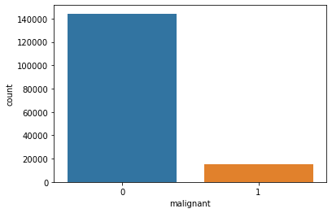
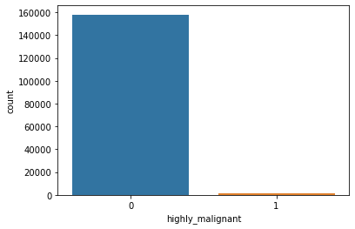
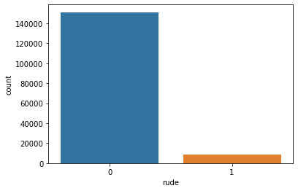
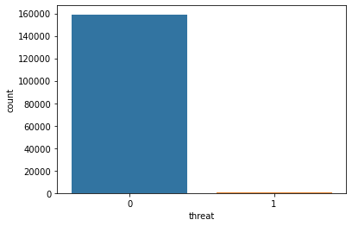
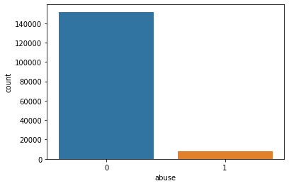

Analytical Problem Framing
.
We can see that there only minimum number of columns in 'malignant', 'highly malignant', 'rude', 'threat', 'abuse', 'loathe' and remaining all in 0.

Slide 6
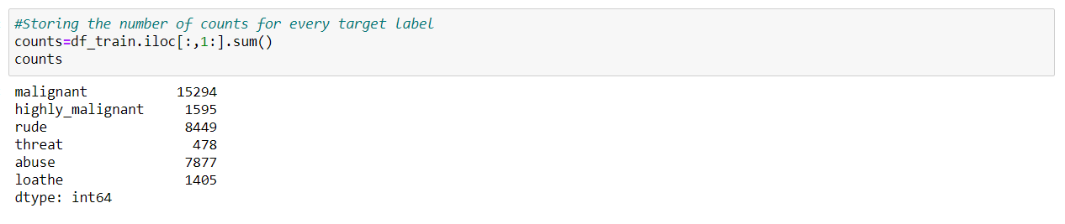
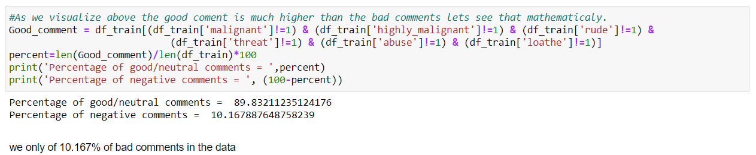
Analytical Problem Framing
.
So, only 10% of the data is getting classified as malignant comments data is unbalanced.

Slide 7
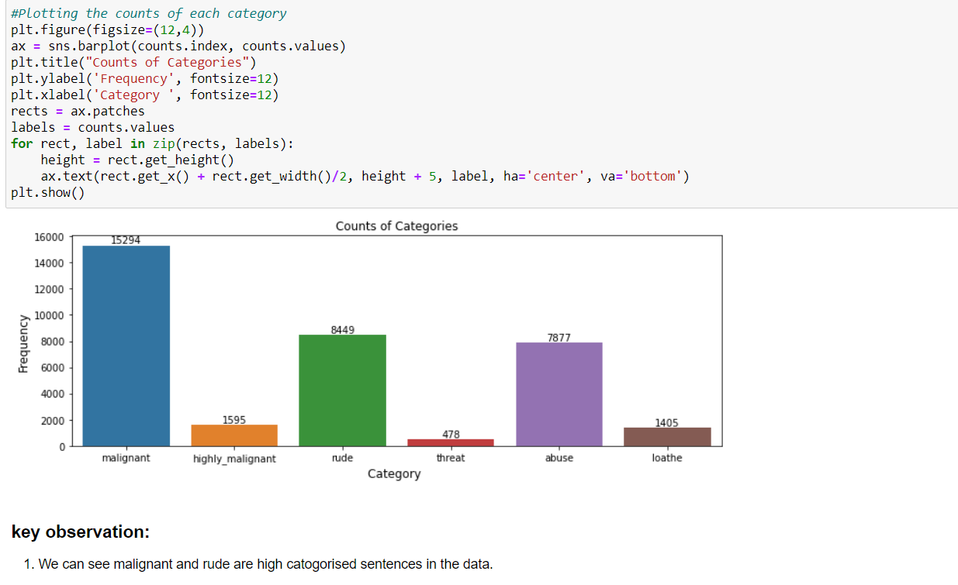
Analytical Problem Framing
.
We can see malignant and rude are high categorised sentences in the data.

Slide 8
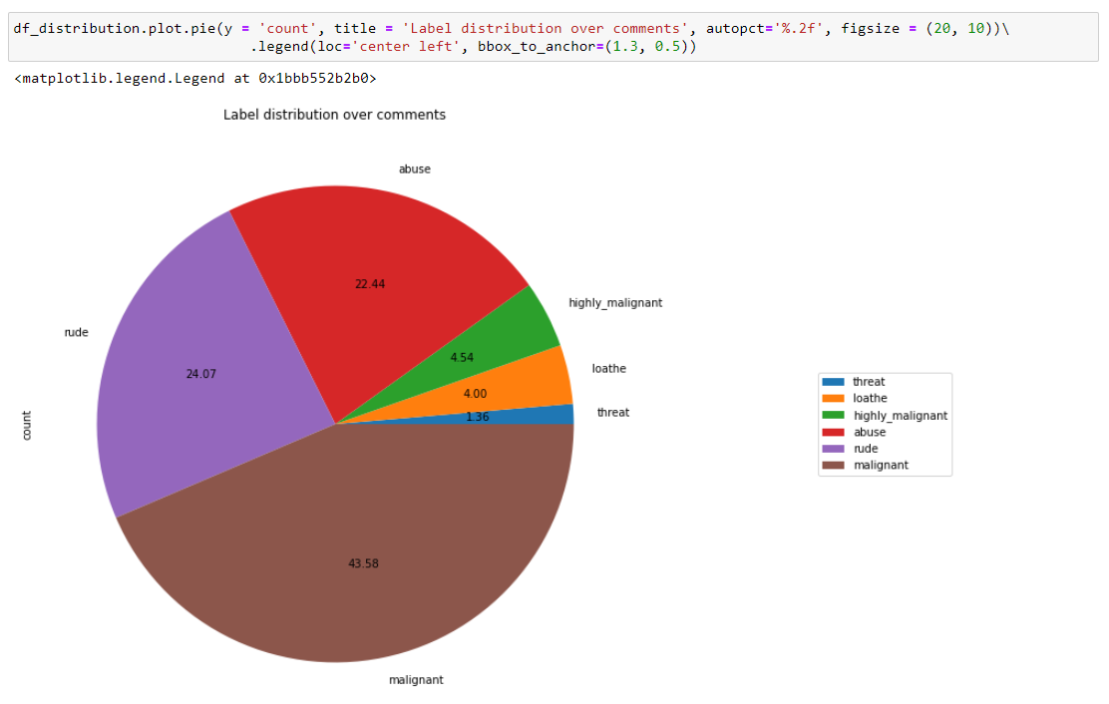
Analytical Problem Framing
.
As we see above malignant, and rude sentence are high classified and threat, loathe are least classified.

Slide 9
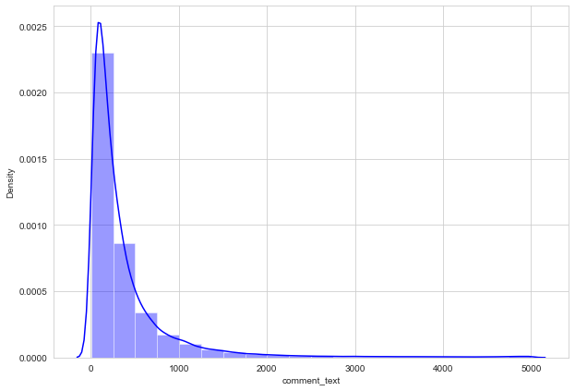
Analytical Problem Framing
.
We can see that few sentences are really long but most of the sentence are small.

Slide 10
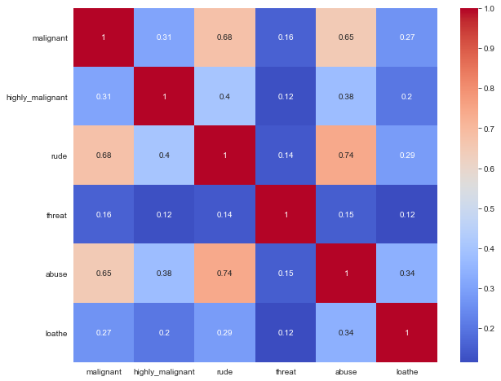
Analytical Problem Framing
.
We can see more corelations in the variables, Abuse have more corelation with malignant and rude.
Rude has more positive corelation with malignant
we don’t have any negative corelations in the data.

Slide 11
Data Sources and their formats
The data set includes:
Malignant: It is the Label column, which includes values 0 and 1, denoting if the comment is malignant or not.
Highly Malignant: It denotes comments that are highly malignant and hurtful.
Rude: It denotes comments that are very rude and offensive.
Threat: It contains indication of the comments that are giving any threat to someone.
Abuse: It is for comments that are abusive in nature.
Loathe: It describes the comments which are hateful and loathing in nature.
ID: It includes unique Ids associated with each comment text given.
Comment text: This column contains the comments extracted from various social media platforms.
Notes:
*OPTIONAL SLIDE* If you are interested in learning more about social groups, look up the caste or class system.

Slide 12
EDA
Exploratory Data Analysis
Word to Vectors (preprocessing)
Hardware and Software Requirements
I have started in clearing the unwanted column. Id have all unique values so I dropped id
Importing required libraries.
Cleansing and preprocessing the data.
As a part of preprocessing I imported TFIDF vectorizer to convert words to vectors.
Imputing these vectors I have trained the model
Python 3.8.
NumPy.
Pandas.
Matplotlib.
Seaborn.
SciPy
Notes:
Think about the questions listed above and answer them.
Can you think of anything else in regards to economy and trade that you would like to add?

Slide 13
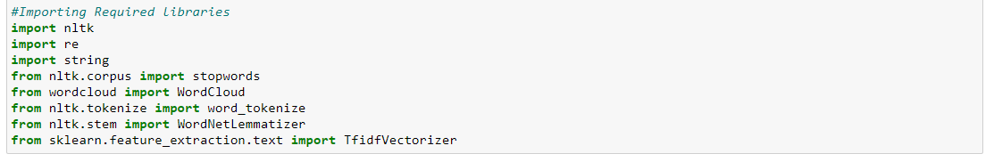
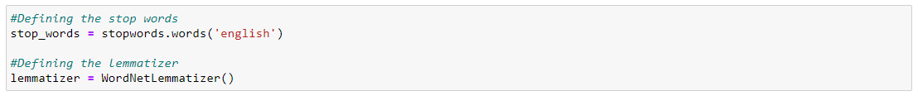
Data Cleansing
<Importing the Required Libraries>
After importing all the required libraries, I have defined stopwords and lemmatize to a variable
Notes:
What is the name of your colony song?
Write lyrics to the song and, if you are feeling creative, use a computer program or instruments to create the music that goes along with it!
To insert an audio file, click on Recording -> Audio -> Audio on My PC and choose your file

Slide 14
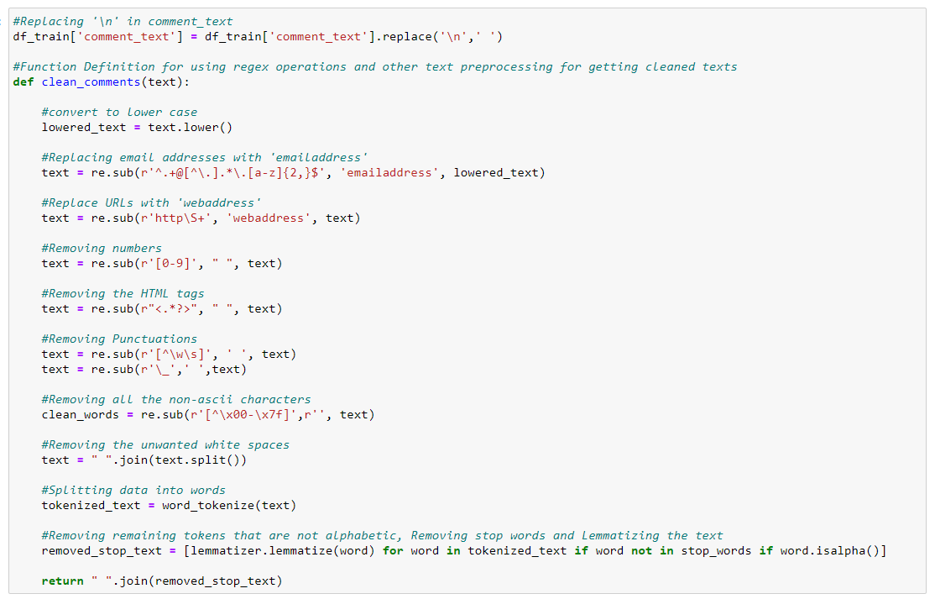
Data Cleaning
Function to clean data.
Notes:
What is the name of your colony song?
Write lyrics to the song and, if you are feeling creative, use a computer program or instruments to create the music that goes along with it!
To insert an audio file, click on Recording -> Audio -> Audio on My PC and choose your file

Slide 15
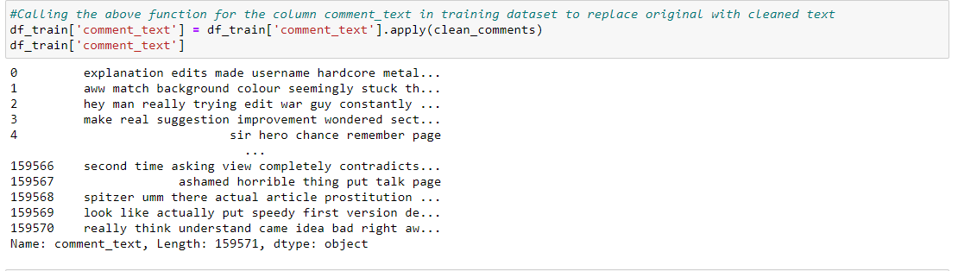
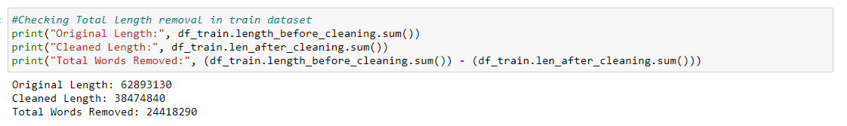
Data Cleansing
Post creating a function, I have passed my data into the same to clean it
Notes:
What is the name of your colony song?
Write lyrics to the song and, if you are feeling creative, use a computer program or instruments to create the music that goes along with it!
To insert an audio file, click on Recording -> Audio -> Audio on My PC and choose your file

Slide 16
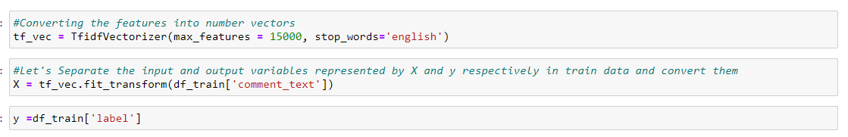
Word to Vec
Word -Vector
And I have split the data into two parts X and y and made them ready for training. I have created a new feature name label and summed all the other numerical column and changed the output as binary i.e., if the sentence is categorised as malignant it will be 1 or else it will be 0
Notes:
What is the name of your colony song?
Write lyrics to the song and, if you are feeling creative, use a computer program or instruments to create the music that goes along with it!
To insert an audio file, click on Recording -> Audio -> Audio on My PC and choose your file

Slide 17
insights and model building
Insights
Model building
Hyper Parameter tuning
Using wordcloud I have build multiple insights.
I have trained the data with eight different model and have sorted one on basis of the performance.
Using GridSearch CV I have tuned the model for increase in performance.
Notes:
Use the SmartArt to determine the flow of government/leadership:
Who leads the colony (executive)? What is that person/are those people’s duties?
Who makes the rules (legislature)?
Who ensures the rules are followed (judicial)?
Are there any other branches of government? If so, who are they and what is their job?
To add more shapes, click on the left shape first, then on SmartArt Tools -> Design -> Add Shape After
Do the same for the shape to the right
Feel free to rename the branches!

Slide 18
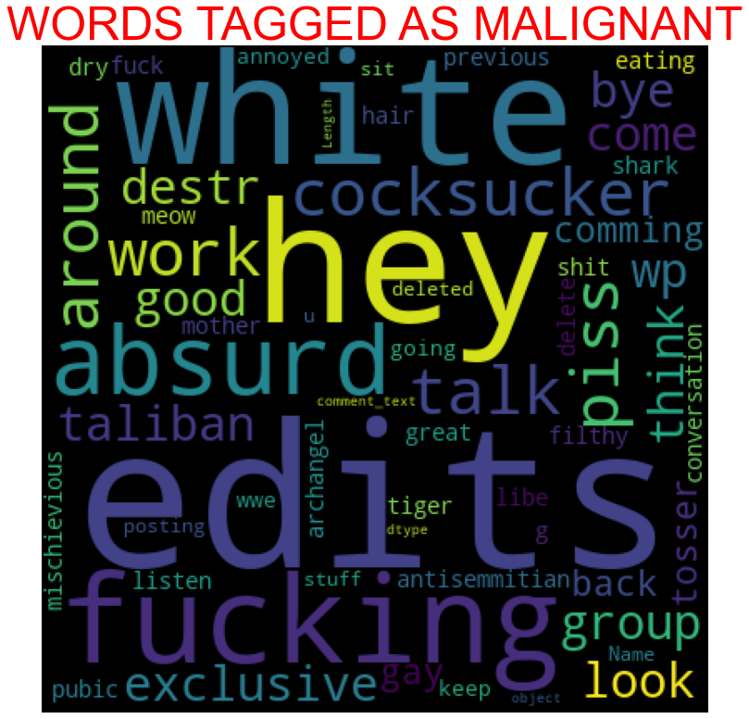
WordCloud
Key observation.
We can see the foul words that are mostly used in malignant classified sentences we are seeing top 400 words the words which are bigger in size are mostly used.
Notes:
Think about the questions/situations listed above and answer them.
Can you think of anything else in regards to transportation that you would like to add?

Slide 19
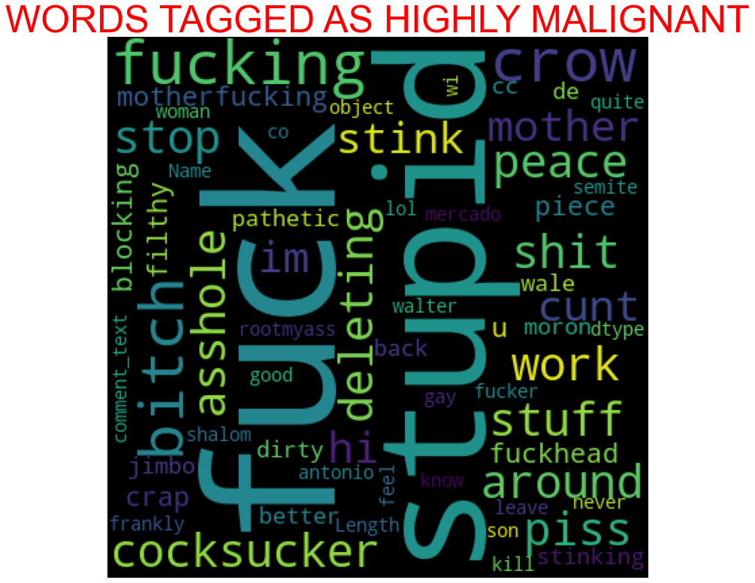
WordCloud
Key observation.
We can see the foul words that are mostly used in highly malignant classified sentences we are seeing top 400 words the words which are bigger in size are mostly used
Notes:
Think about the questions/situations listed above and answer them.
Can you think of anything else in regards to transportation that you would like to add?

Slide 20
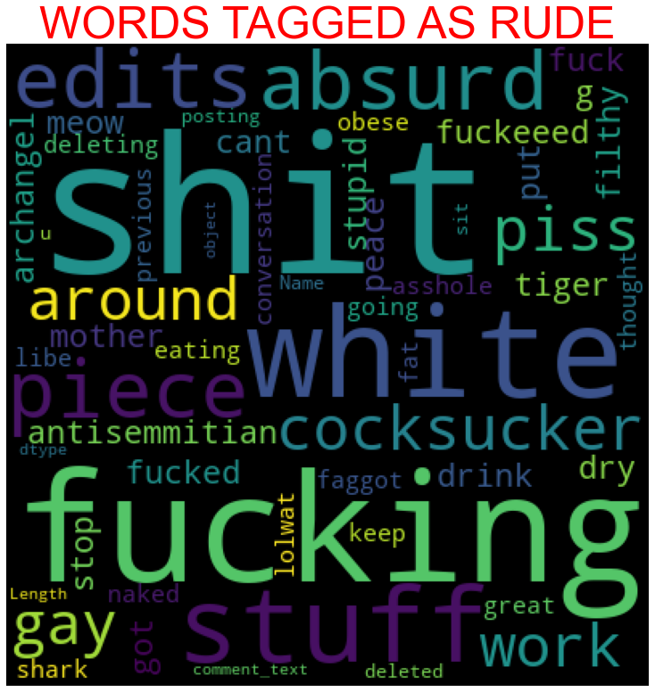
WordCloud
Key observation.
We can see the foul words that are mostly used in rude classified sentences we are seeing top 400 words the words which are bigger in size are mostly used.
Notes:
Think about the questions/situations listed above and answer them.
Can you think of anything else in regards to transportation that you would like to add?

Slide 21
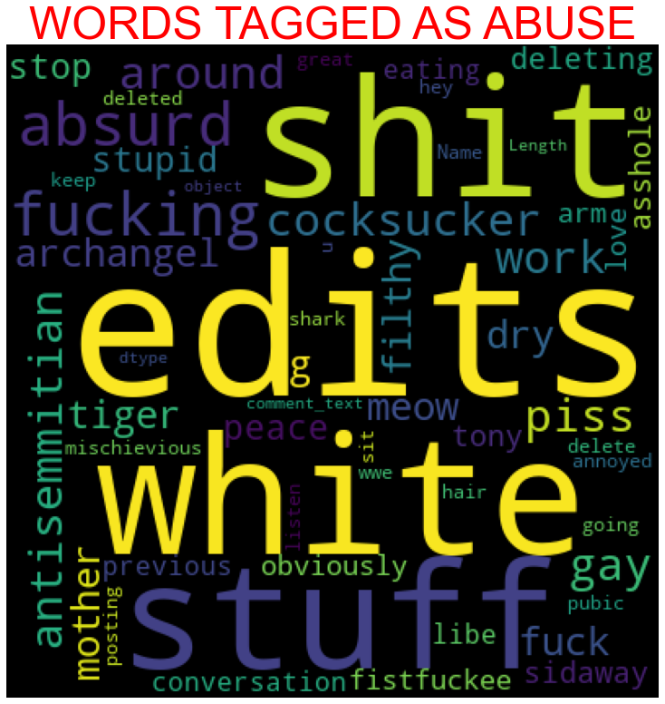
WordCloud
Key observation.
We can see the foul words that are mostly used in abuse classified sentences we are seeing top 400 words the words which are bigger in size are mostly used.
Notes:
Think about the questions/situations listed above and answer them.
Can you think of anything else in regards to transportation that you would like to add?

Slide 22
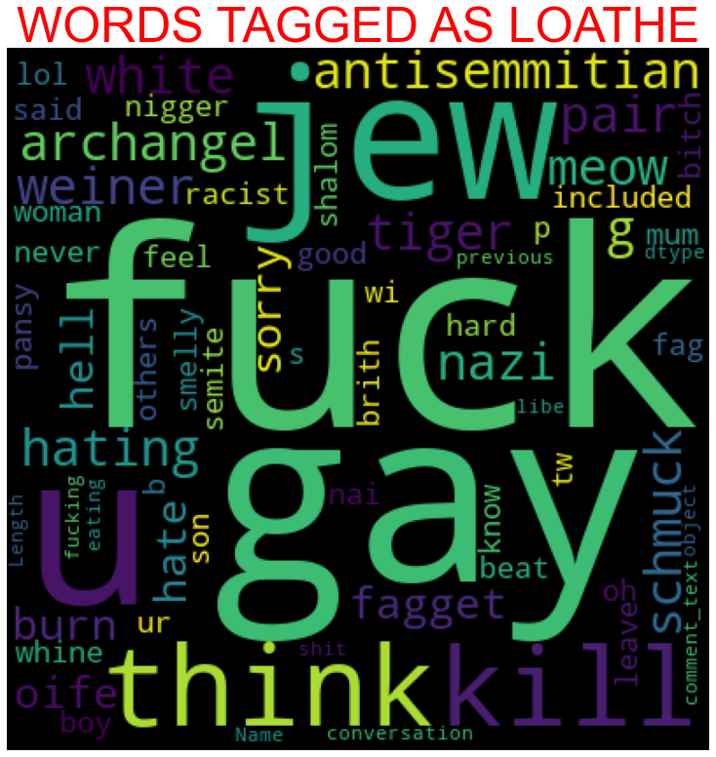
WordCloud
Key observation.
We can see the foul words that are mostly used in malignant classified sentences we are seeing top 400 words the words which are bigger in size are mostly used.
Notes:
Think about the questions/situations listed above and answer them.
Can you think of anything else in regards to transportation that you would like to add?

Slide 23
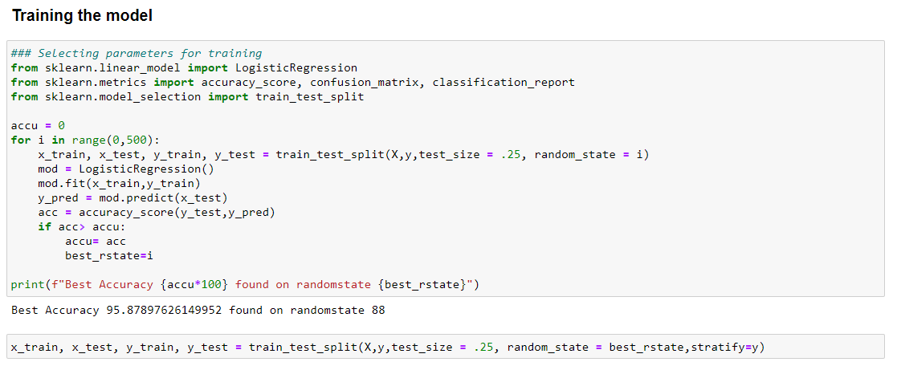
Model(s) Development and Evaluation
Training the model
Notes:
What is the name of your colony song?
Write lyrics to the song and, if you are feeling creative, use a computer program or instruments to create the music that goes along with it!
To insert an audio file, click on Recording -> Audio -> Audio on My PC and choose your file

Slide 24
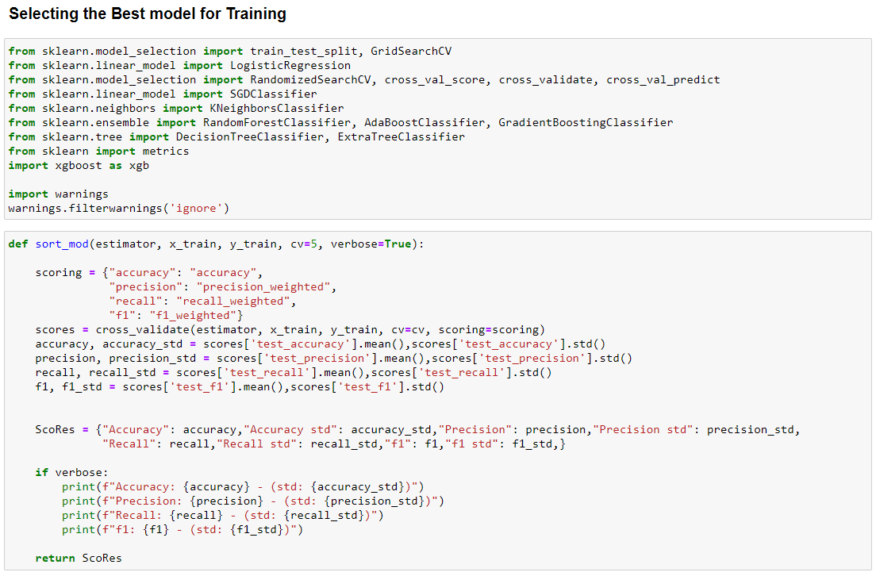
Model(s) Development and Evaluation
Training the Model
Notes:
What is the name of your colony song?
Write lyrics to the song and, if you are feeling creative, use a computer program or instruments to create the music that goes along with it!
To insert an audio file, click on Recording -> Audio -> Audio on My PC and choose your file

Slide 25
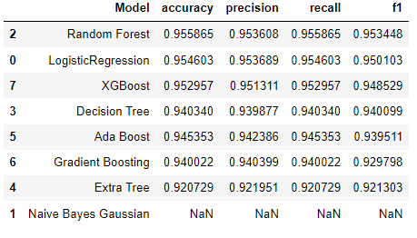
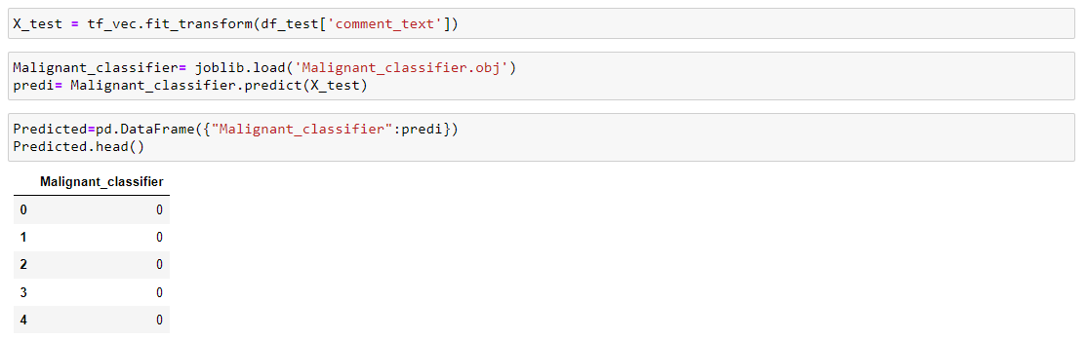
Model(s) Development and Evaluation
Shortlist the Trained Model
As we can see above Random Forest tops the chart, I have selected Random Forest model as my final model and I have saved the same for the further usage. Further I have imported the test data and have done prediction on the same.
Notes:
What is the name of your colony song?
Write lyrics to the song and, if you are feeling creative, use a computer program or instruments to create the music that goes along with it!
To insert an audio file, click on Recording -> Audio -> Audio on My PC and choose your file

Slide 26
Conclusion
Key Findings and Conclusions of the Study
The finding of the study is that only few users over online use unparliamentary language. And most of these sentences have more stop words, and are being long. As discussed before few motivated disrespectful crowds uses these foul languages in the online forum to bully the people around and to stop them from doing the things that they are suppose to do. Our Study helps the online forms and social media to induce a ban to profanity or usage of profanity over these forms.
Notes:
Have fun with this slide! Use drawing paper or inking to create your colony’s flag, flower, bird, tree, and its most famous person!
If you use drawing paper, take a photo and insert the image
If you choose to use digital inking, click on the Draw tab and ink away!

Slide 27
Conclusion
Learning Outcomes of the Study in respect of Data Science
I have developed our system based on a foul language classification approach; it is based on an improved version of a Random Forest Classification Algorithm that detects offensive language usage in a conversation. As per our evaluation, we found that lesser number of users conversation is not decent all the time. We trained 159571 observations for eight context categories using a Random Forest algorithm for context detection. Then, the system classifies the use of foul language in one of the trained contexts in the text conversation. In our testbed, we observed 10% of participants used foul language during their text conversation. Hence, our proposed approach can identify the impact of foul language in text conversations using a classification technique and emotion detection to identify the foul language usage
Notes:
Have fun with this slide! Use drawing paper or inking to create your colony’s flag, flower, bird, tree, and its most famous person!
If you use drawing paper, take a photo and insert the image
If you choose to use digital inking, click on the Draw tab and ink away!

Slide 28
Conclusion
Limitations of this work and Scope for Future Work
The limitation of the study is that we have a imbalanced data so our model learnt more about the non-abusive sentence more than the abusive sentence. Which makes our model act like a overfit model when tested with live data. And also, model tend to not identify a foul or a sarcastically foul language.
Notes:
Have fun with this slide! Use drawing paper or inking to create your colony’s flag, flower, bird, tree, and its most famous person!
If you use drawing paper, take a photo and insert the image
If you choose to use digital inking, click on the Draw tab and ink away!

Slide 29


